Slide 1
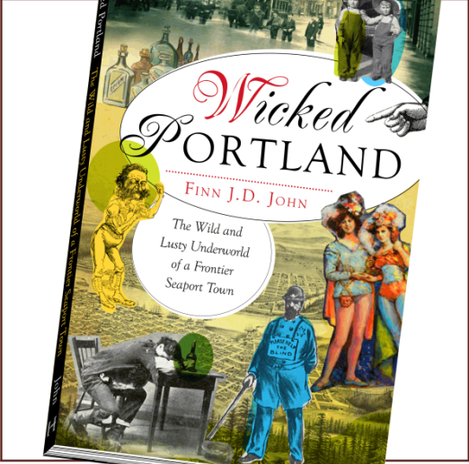
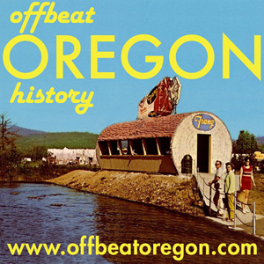
The Ku Klux Klan and the Sellwood Bridge Swindle
Your faithful bus driver:
Finn J.D. John
Author and Public Historian
Notes:
Hello tigers! My name is Finn John.
Some of you already know me.
By day I make a living impersonating a college professor at Oregon State University, and by night — and weekend, and holiday, and any other time I can steal away — I labor in the trenches as an author and public historian,
cranking out a 1,000-word newspaper column and four to five 10-minute podcasts a week and making sure my hub Website hasn’t been hacked yet.
You should check it out sometime, there are at last count 293 columns posted in the archive.
Today I want to talk about one of the most embarrassing skeletons in Oregon’s closet:

Slide 2
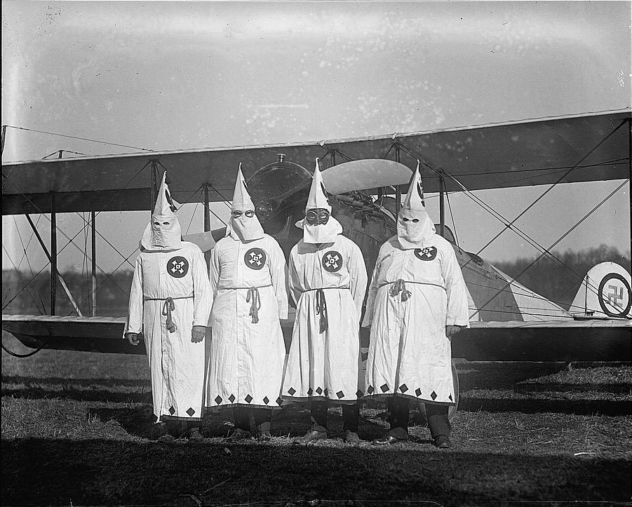
Notes:
Our fair state’s onetime infatuation with a giant nationwide racist con job calling itself the Ku Klux Klan.

Slide 3
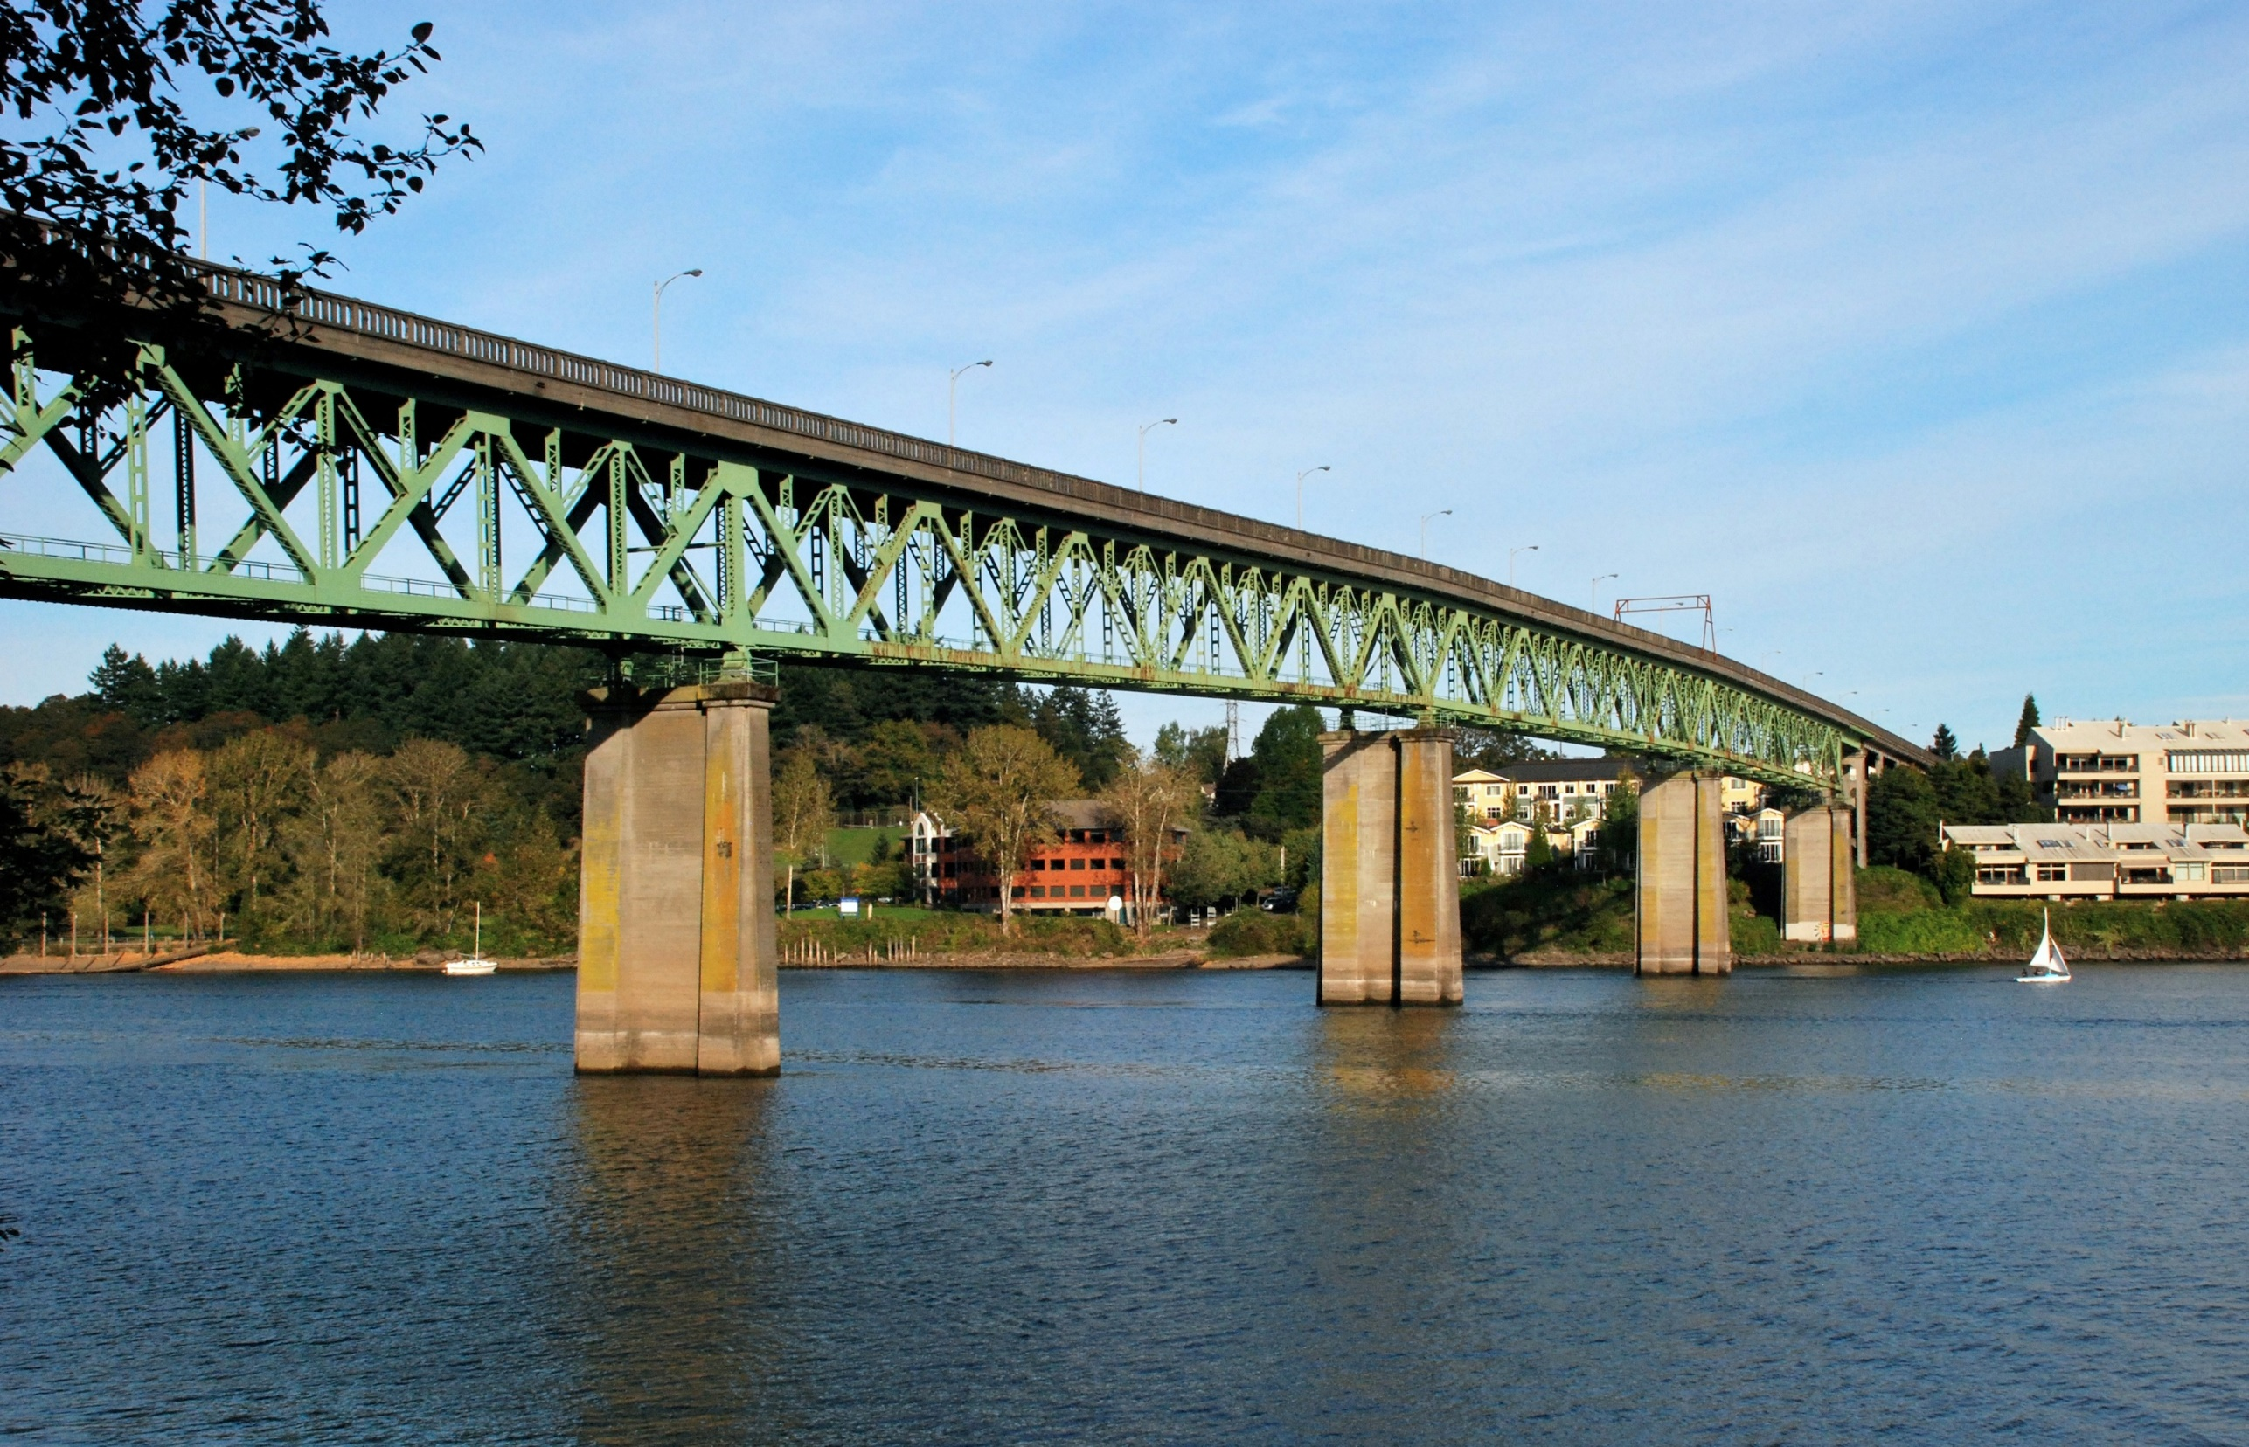
Notes:
And then we have to talk about this bridge.
By the way, the deadline was Friday, right? Did anybody buy it?
That bridge is the star of our story today. It was part of a scandal that rocked this town in 1924. Might have been the biggest scandal of the 1920s …

Slide 4
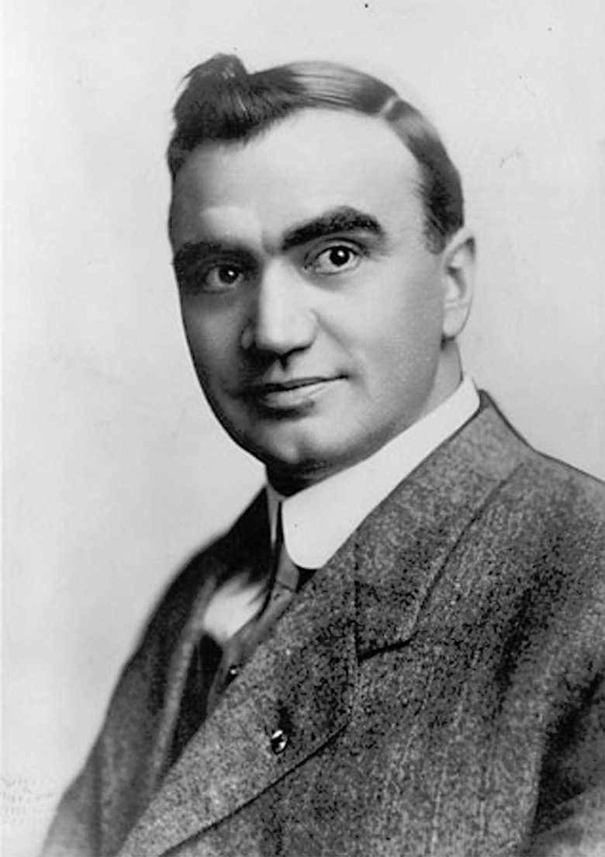
Notes:
… well, except for this guy. This is Mayor George Baker. He had the good luck to be in charge of City Hall during Prohibition …

Slide 5
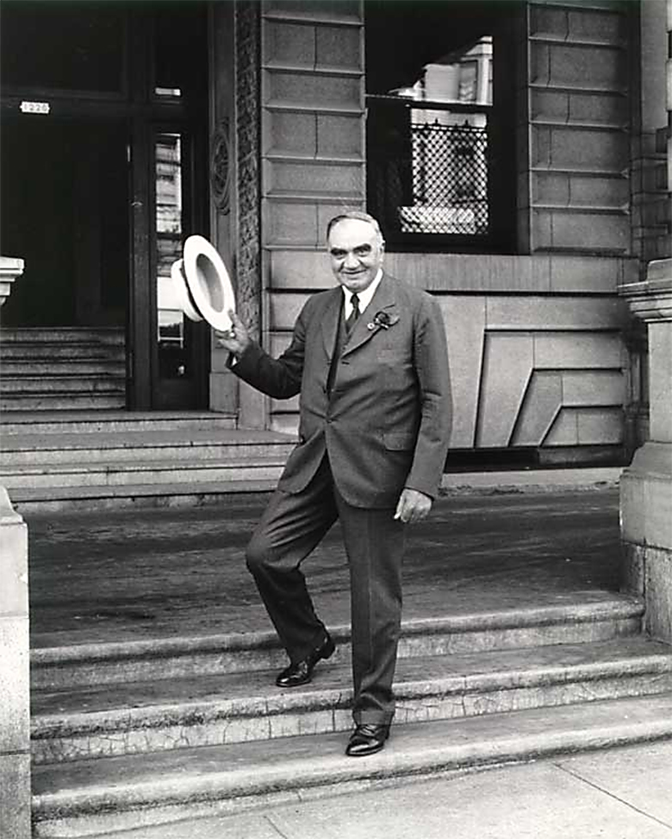
Notes:
which means he and his pals more or less had the entire market to themselves, if you know what I mean …
Also, any Night Vale fans out there? If so, you’ll be pleased to hear that there actually was an organization in Portland called the “Mayor’s Secret Police.”
He used it to break up the Wobblies in ‘22.
But that’s another story. As I was saying, Mayor Baker’s entire tenure in office was probably a bigger scandal than the bridge thing.
Except, well, it was kind of the same scandal.
I’ll show you what I mean by that:

Slide 6
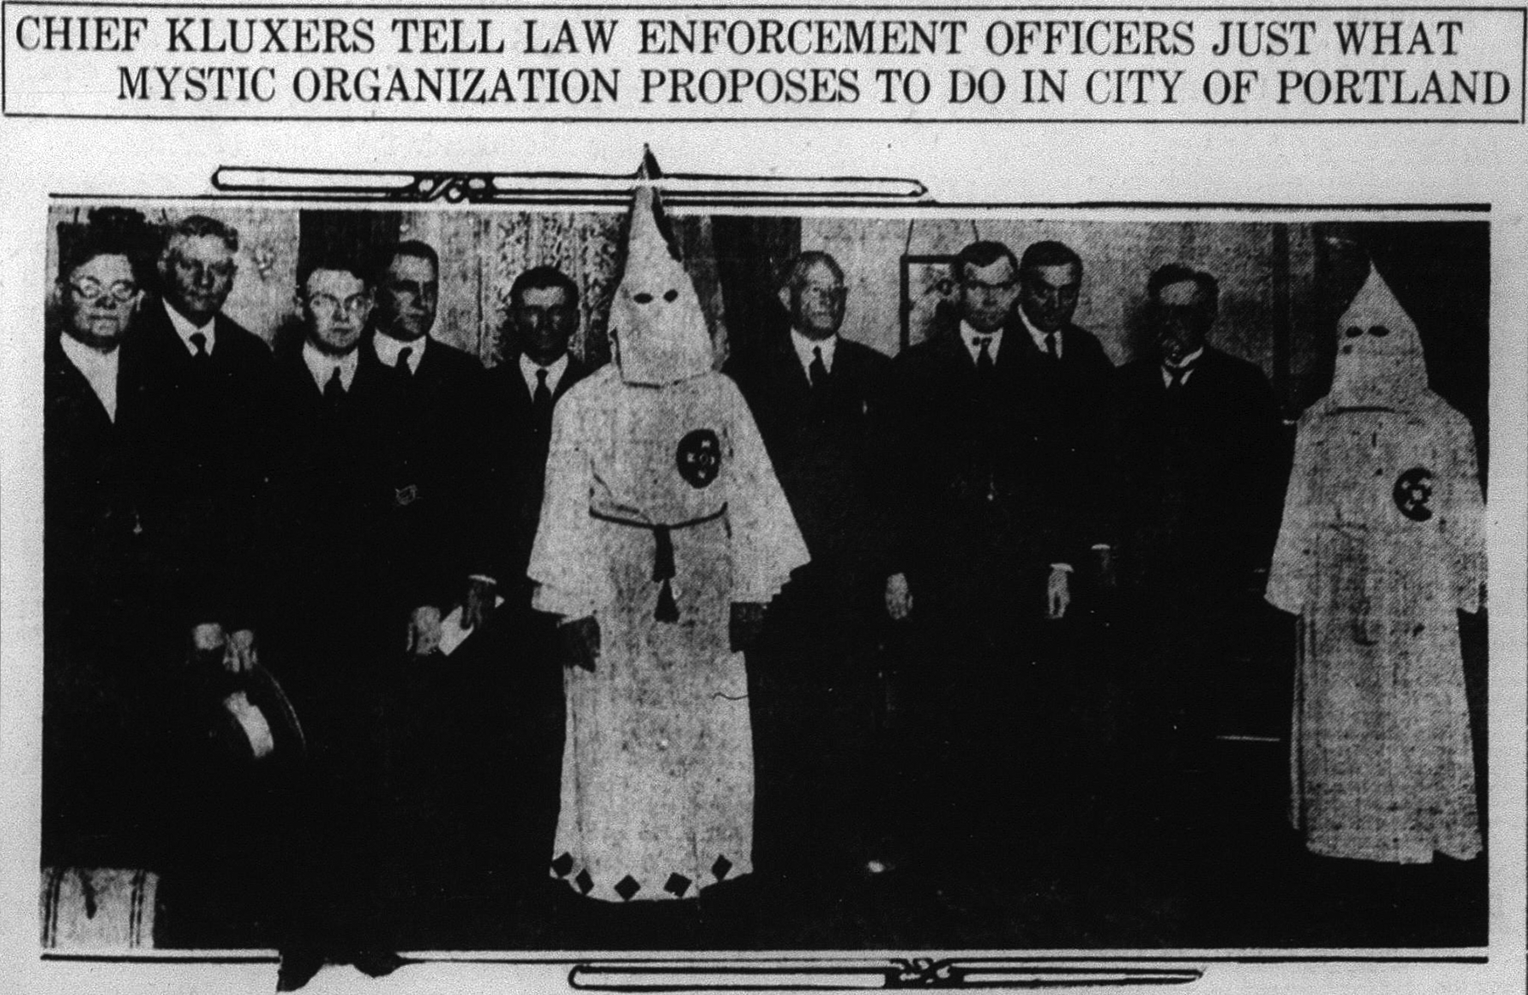
Notes:
That’s our boy right there. George Luis Baker.
With … Here we have a guy from the National Safety Council … the senior captain of the Portland P.D. … the police chief, L.V. Jenkins … the district attorney, Walter Evans … this guy is the federal prosecutor for Portland … here’s Multnomah County Sheriff T.M. Hurlburt … this guy is with the U.S. Department of Justice —
Now, this photo is kinda famous. You’ve probably seen it before.
There is some controversy over this photo.
District Attorney Evans’ son later told legendary Portland historian E. Kimbark MacColl that the photo was a put-up job.
He said the dignitaries in the photo were arranged in front of a velvet curtain and the robed Kluxers popped out from behind the curtain just as the shutter clicked.
OK, fair enough. Just tell me this: Do you see a velvet curtain here? I don’t.
This pic was made in 1921.
Our scandal happened in 1924.

Slide 7
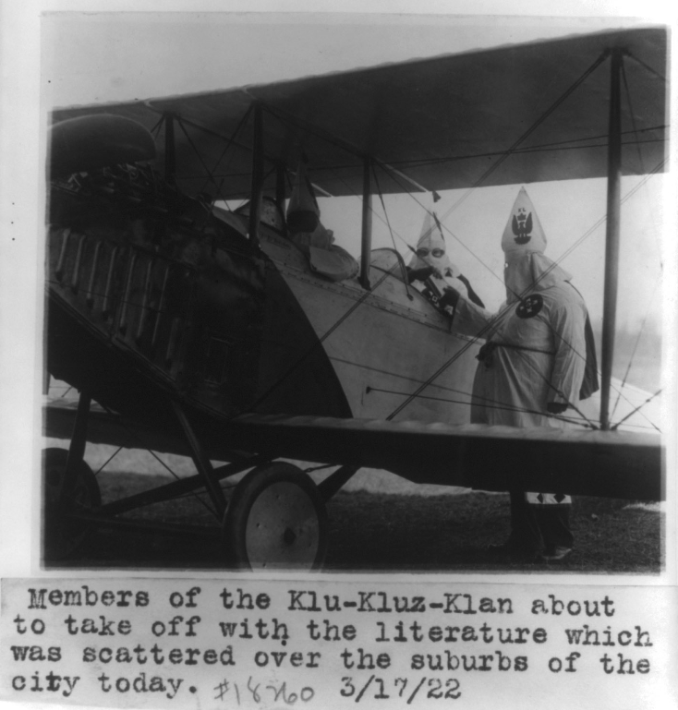
Notes:
Between those years, they were masters of the universe all over Oregon …
… but after the bridge scandal, well — they were still a thing, on into the 1930s, but they never got their hands on the steering wheel again.
But I’m going to start off telling you how they got hold of the steering wheel in the first place.
It’s actually a pretty long story. I’m going to have to skip over some pretty interesting stuff.
Maybe we’ll do the Klan per se on a future date.

Slide 8
The Klan backstory:
How this “mystic organization” came to be
Notes:
For now, the Cliff Notes version:
… starting with a quick explanation of what the Klan was originally.

Slide 9
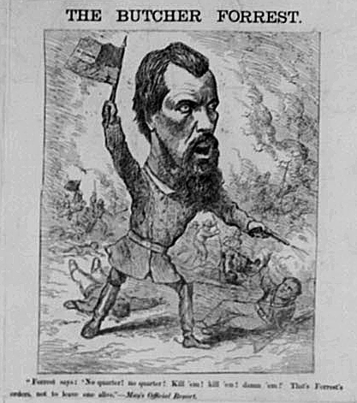
Notes:
The Klan was originally a true terrorist organization.
In 1865, a pissed-off ex-rebel general named Nathan Bedford Forrest started it as an anonymous gang of vigilantes.
Their goal was to resist the Yankee occupation of the old south, and to make sure those former slaves didn’t start getting all — I believe the word is “uppity.”
You know, wanting unreasonable things, like being able to vote.
Or wear a hoodie in public without getting shot. That kind of thing.

Slide 10
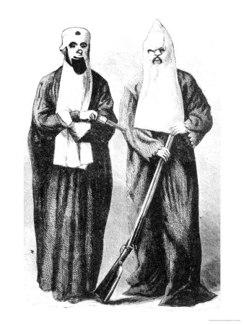
Notes:
It spread quickly and quietly around the old South.
And unlike the later versions that we’re going to talk about today, there was nothing funny or ridiculous about it.

Slide 11
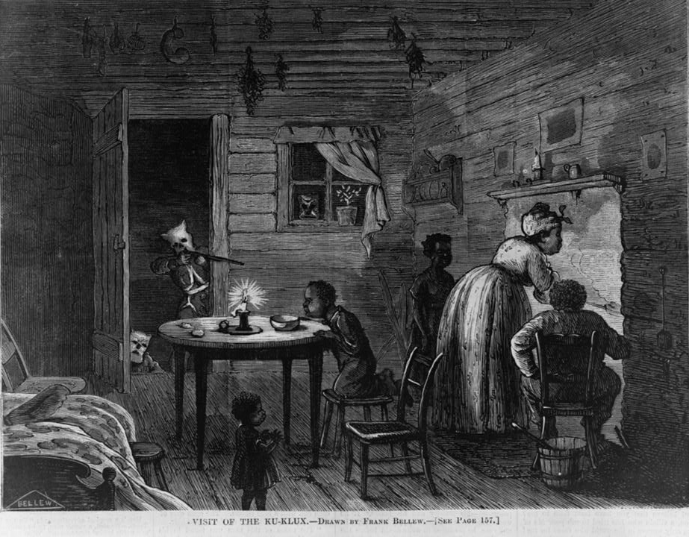
Notes:
Here’s a picture from Harpers Weekly, 1871, that should give you an idea of what these guys were like.
They were straight-up mobs of anonymous self-deputized vigilante assassins sneaking around the country killing people and leaving their bodies on the road so that their friends and relatives could see what happened to them.
This primarily happened to free black people.
A rumor that you were a “black Republican” could be turned into a death warrant with alarming ease.
They also targeted white carpetbaggers and “scalawags,” but these were usually tarred and feathered, not tortured and killed.

Slide 12
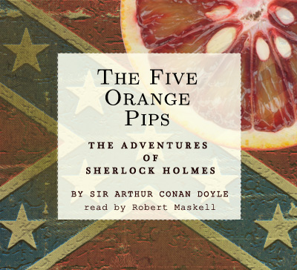
Notes:
Any of you ever read this Sherlock Holmes story? “The Five Orange Pips”? When it talks about the Klan, this is the one it means.

Slide 13
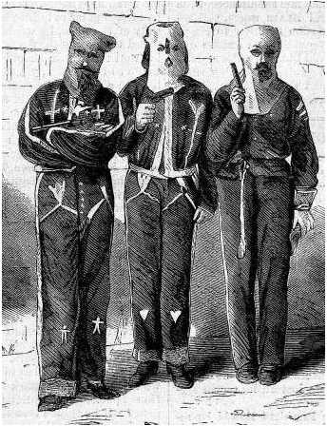
Notes:
By the 1870s, all these Klanners were getting out of hand.
Something had to be done.

Slide 14
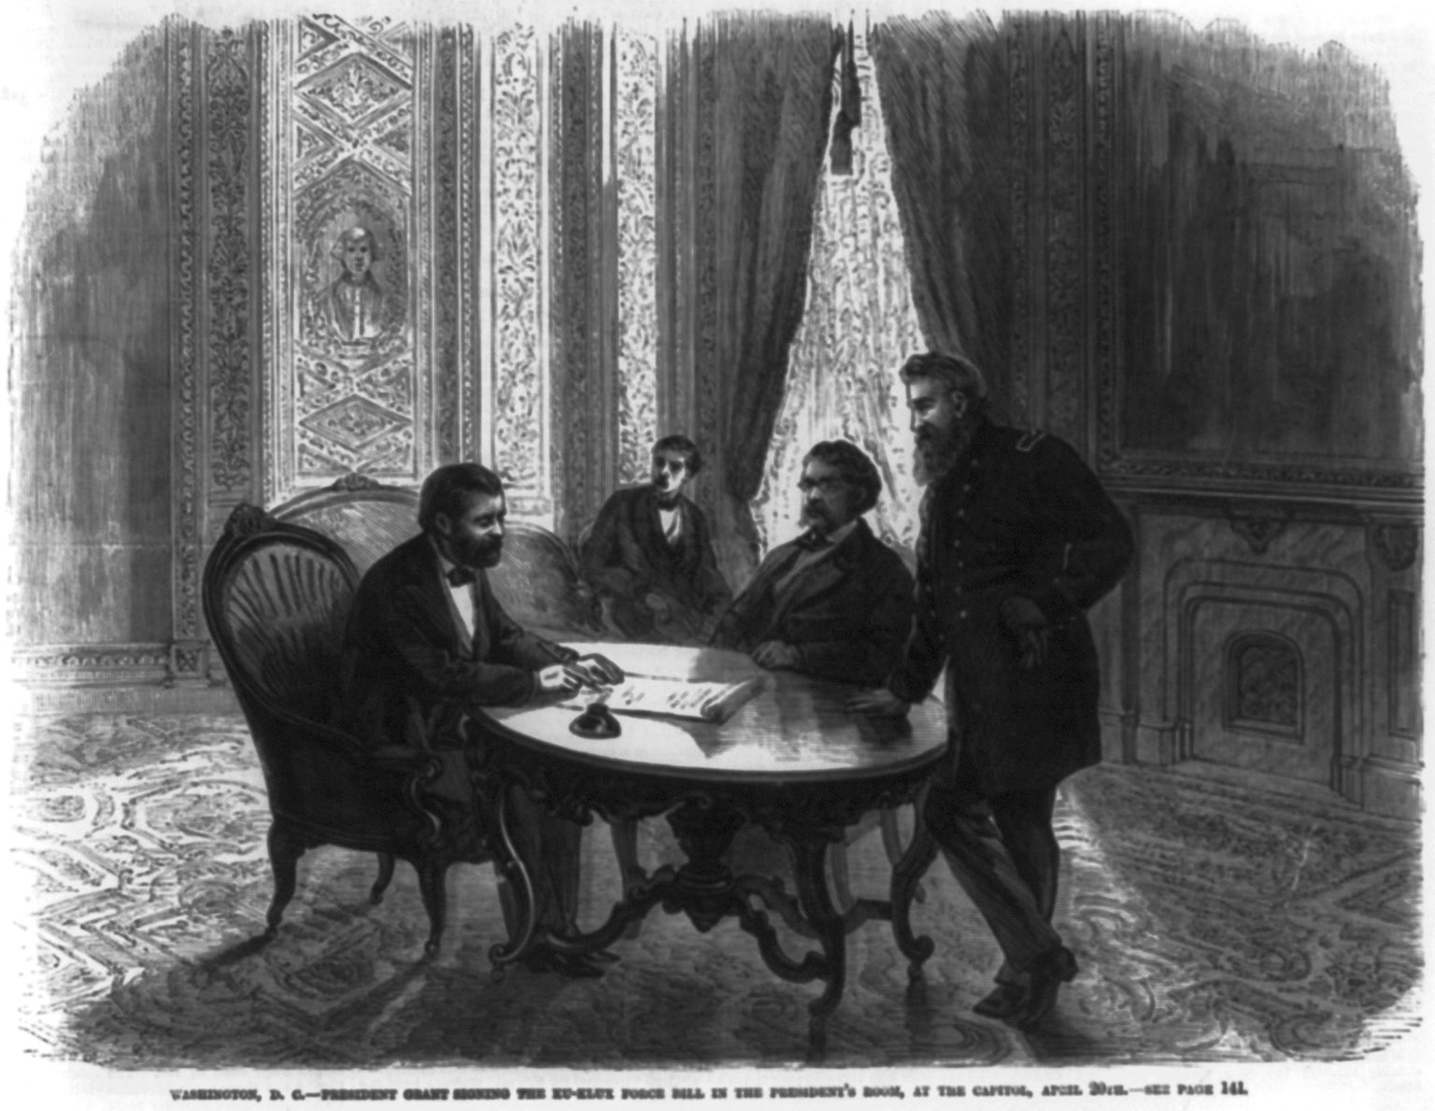
Notes:
So in 1871, Ulysses S. Grant and the congress passed something called the Ku Klux Force Act.
Here he is signing it.

Slide 15
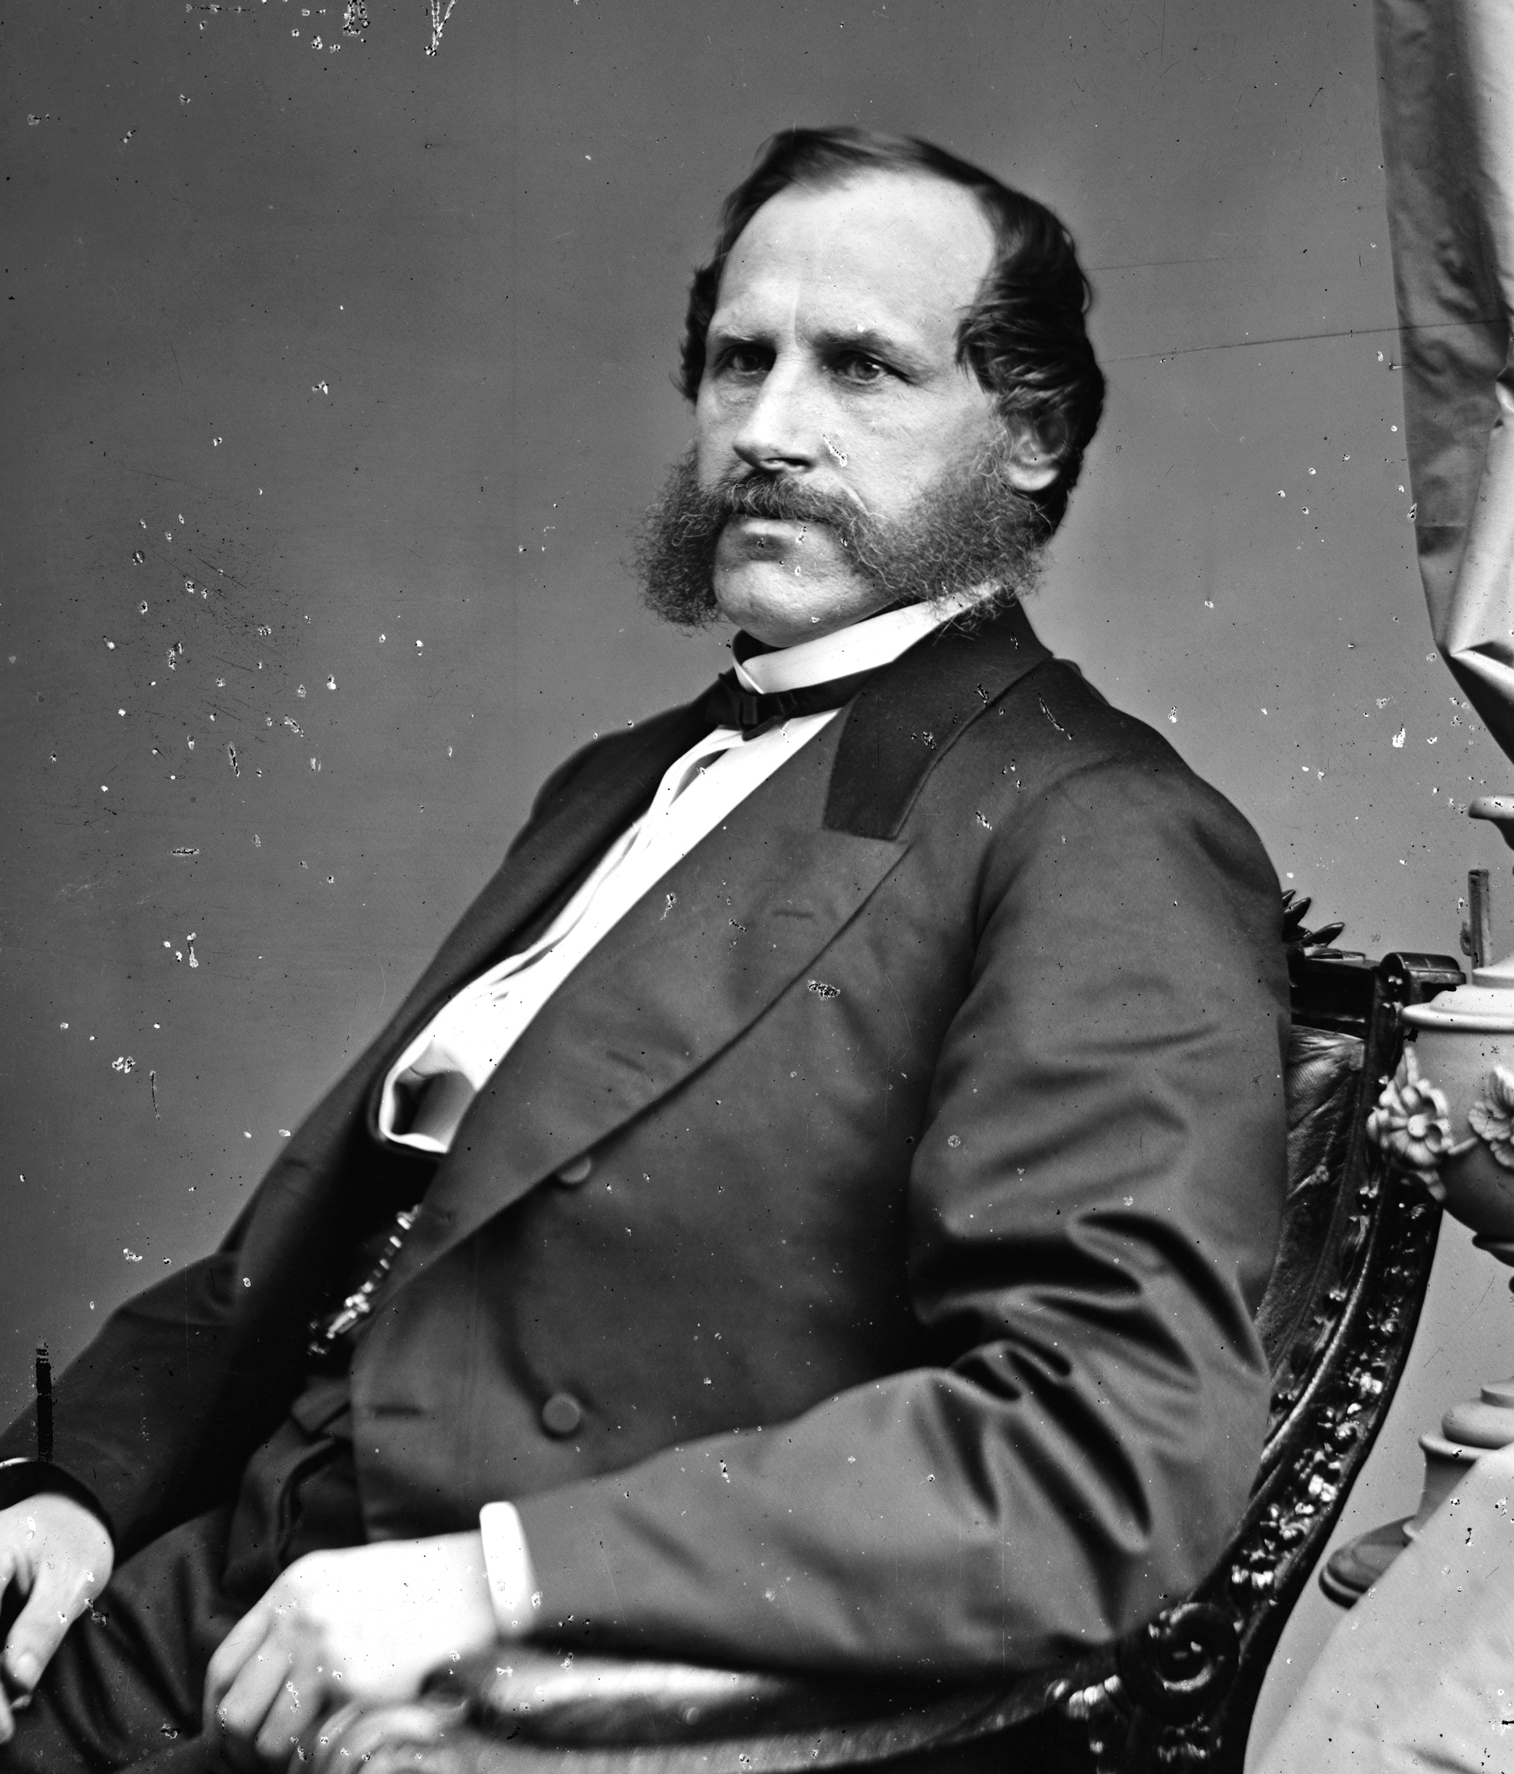
Notes:
Under the direction of Attorney General George Williams — an Oregon guy and later mayor of Portland — the Department of Justice let ‘em have it.
Hundreds of these skulking murderers were rounded up, tried by juries that were often made up largely of black people, and tossed in the slammer.
This campaign was so successful that within a year or so the Klan was finished and gone.

Slide 16
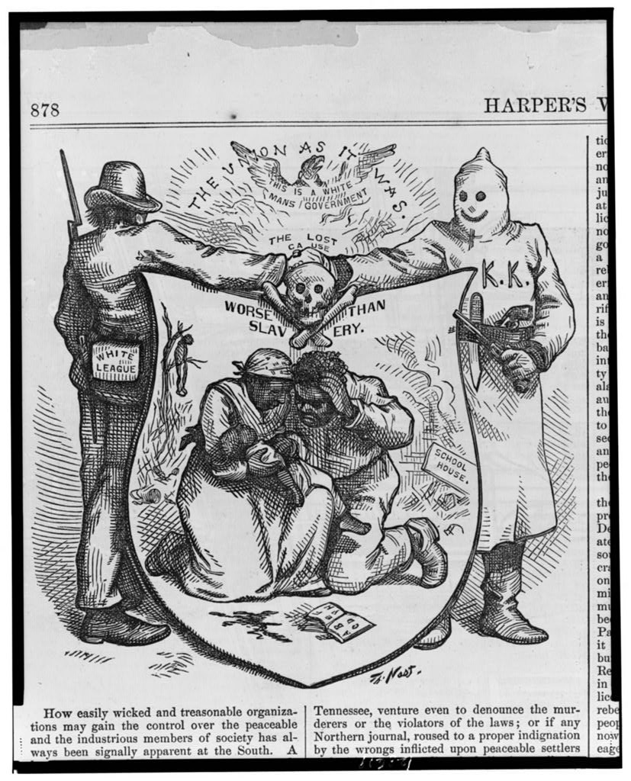
Notes:
That was the end of the Ku Klux Klan for 35 years, although other organizations and “white leagues” and outfits like that carried the torch.
Until …

Slide 17
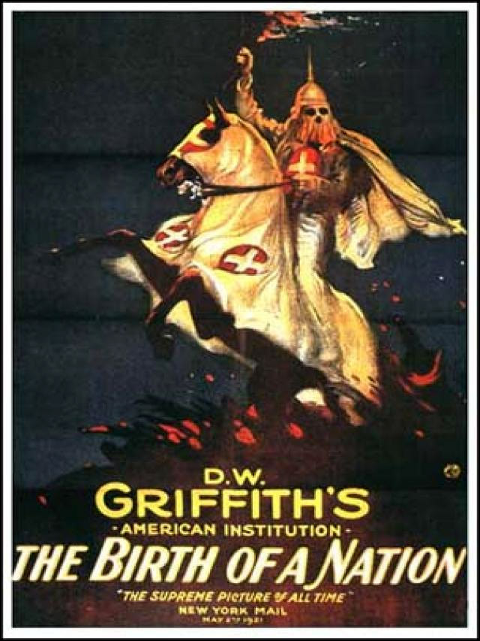
Notes:
… this movie came out.
The Birth of a Nation.
Based on writer Thomas Dixon’s books — The Leopard’s Spots, The Clansman and The Traitor — what he called his Ku Klux Klan Trilogy.

Slide 18
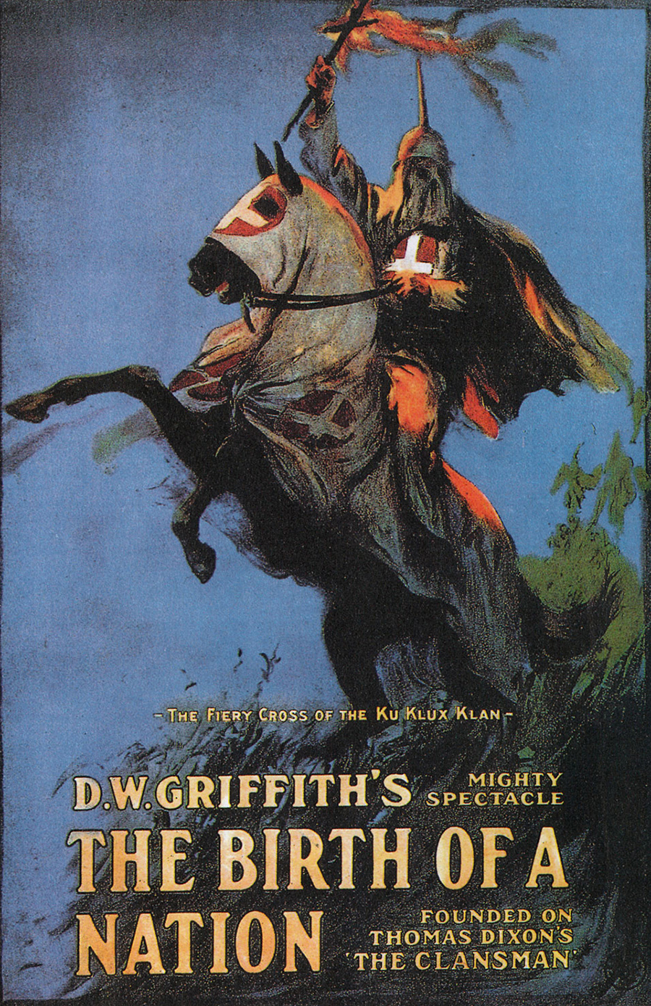
Notes:
Birth of a Nation is kind of complicated.
Also, incredibly reductive, clumsily emotionally manipulative — and, of course, offensive.
It’s the story of two families separated by the Civil War, coming together afterward with wedding bells on their minds only to be thwarted by this dystopic racist fantasy regime of black rule in the South.
It’s presented as legit history of the reconstruction era.

Slide 19
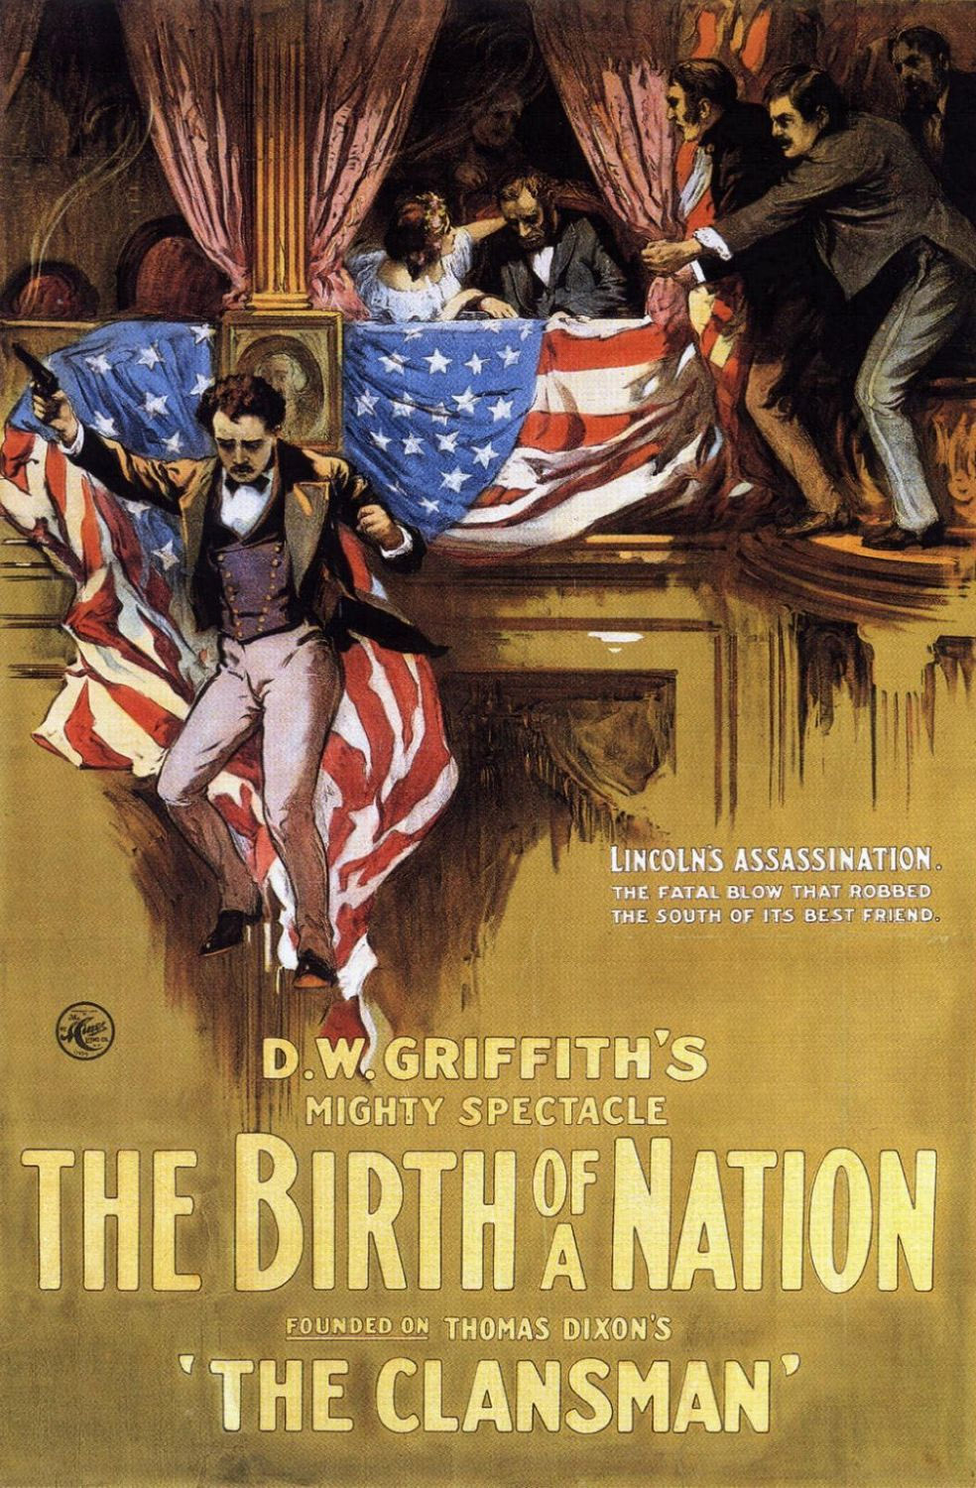
Notes:
It features black legislators lounging around the state house drinking and carousing and bullying white voters into not voting.
Then we get the obligatory Pure Virgin Damsel throwing herself off a cliff to avoid being ravished by an amorous black soldier.
Well, not exactly ravished.
It’s more like, he wants her to agree to marry him, and she decides she’d rather die than temporarily pretend to be interested.

Slide 20
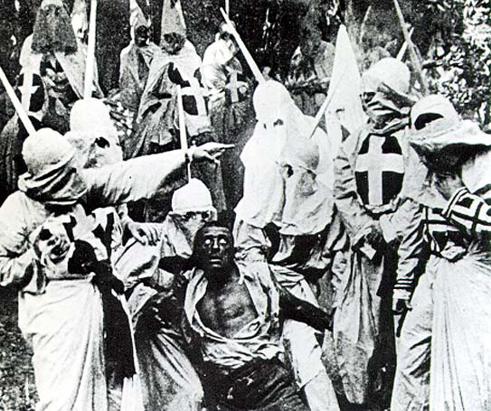
Notes:
But hey, that’s a good enough reason for the guy to be hunted down and lynched by an avenging Ku Klux Klan as you, gentle theater-goer, are encouraged to cheer and to celebrate the triumph of Vigilante Justice.
Seriously. This is a screenshot from the movie.
It’s the director’s plan for you to be howling for that man’s blood right now.
Also, you should know, since the quality is so poor that you can’t see it, that that actor is a white guy in blackface.
There’s more, but you get the idea.

Slide 21
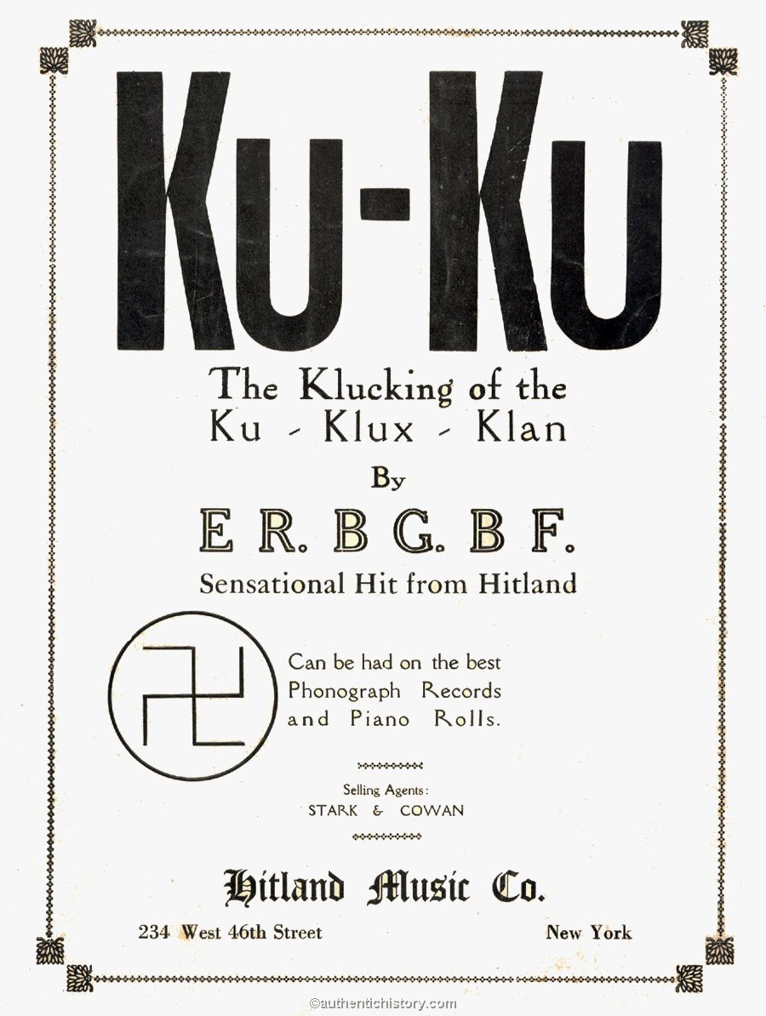
Notes:
Birth of a Nation inspired a new Klan to spring up in Atlanta the same year it came out — 1915.
The founder styled this new one after the fraternal organizations of the day — he was a member of about a dozen of them, outfits like the Masons and the Elks and the Woodsmen of the World, or ...

Slide 22
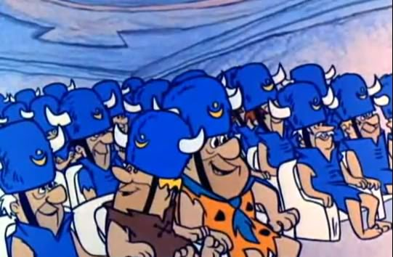
Notes:
… the Loyal Order of Water Buffalo.
He also made up a bunch of incredibly doltish-sounding titles for various jobs in his new gang:
The treasurer was a Klabee, the secretary was a Klagrapp, a mobbing-up was a Klonvocation and — get this — their sacred record book was a Kloran.

Slide 23
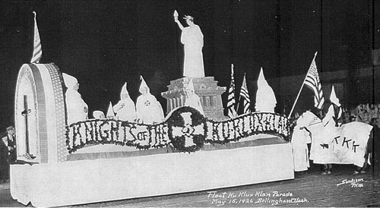
Notes:
And they paraded up and down the street in front of the theater in Atlanta while all those people flocked in to watch Birth of a Nation, and everybody felt great and powerful.
But five years later there still were only 5,000 Klowns signed up, and only in the South.
The founders wanted more … but how to get it?

Slide 24
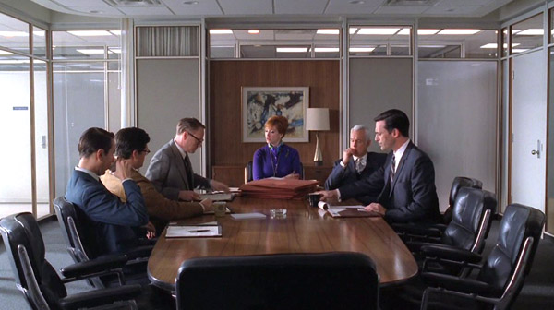
Notes:
Easy enough. Just hire an agency.
There was this new P.R. and Advertising agency that had formed, see, called the Southern Publicity Association.
They came up with a plan that would spread the Klan around the country like krabgrass.

Slide 25
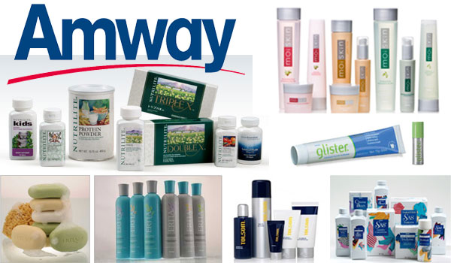
Notes:
Uh-huh. That’s right.
Now, there’s nothing wrong with Amway.
They make good stuff.
They market it in a pretty annoying way, but there’s nothing wrong with their products.
But have you ever had a friend pitch you on it? It’s a multilevel thing, right?

Slide 26
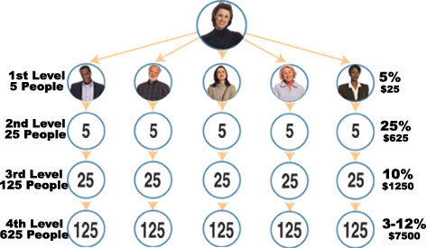
Notes:
So your friend signs you up and you start buying all your crap through their catalog, and your friend gets a piece of the action.
Then you sign up another friend, who starts buying all his/her crap through the catalog, and you get a piece of the action, and the guy who signed you up also gets a piece of it.
The idea is, at some point you can just kick back and cash checks for a living while all the worker bees you signed up make money for you.

Slide 27
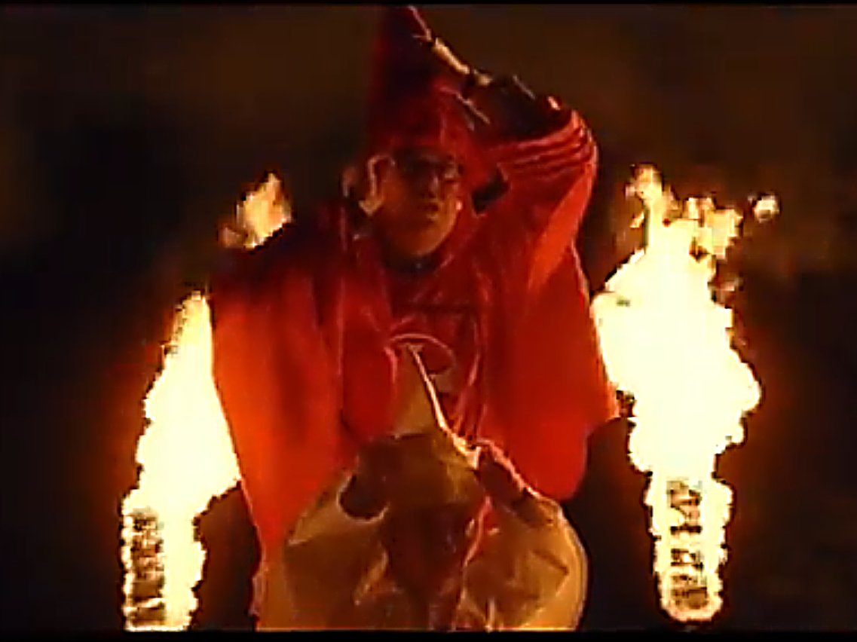
Notes:
Well, that’s kind of how the Southern Publicity Association set up the Klan.
It sent forth a small cohort of “kleagles” — recruiters — to rant at people about “100% pure Americanism” and sign folks up for $10 plus whatever a Klown suit cost.

Slide 28
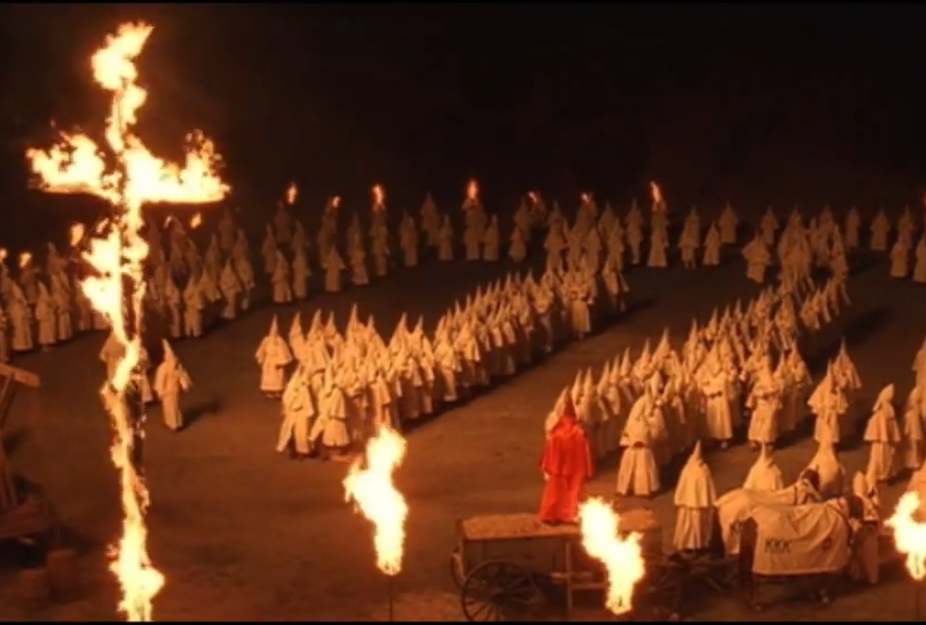
Notes:
They got to stick $4 of that $10 in their pockets, plus skim off part of the cost of the Klown suits, which — I happen to have a catalog here —

Slide 29
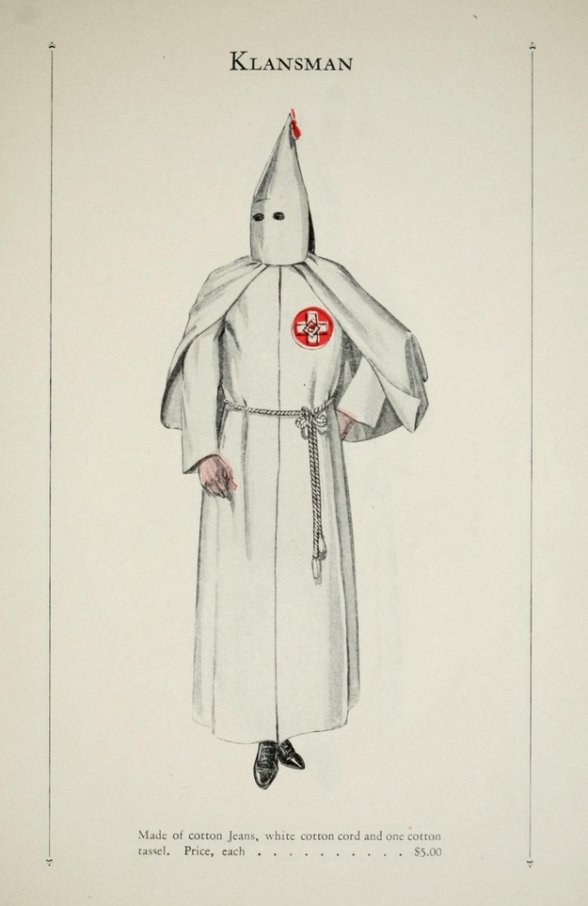
Notes:
… started at 5 bucks for this Little Black Dress type number ….

Slide 30
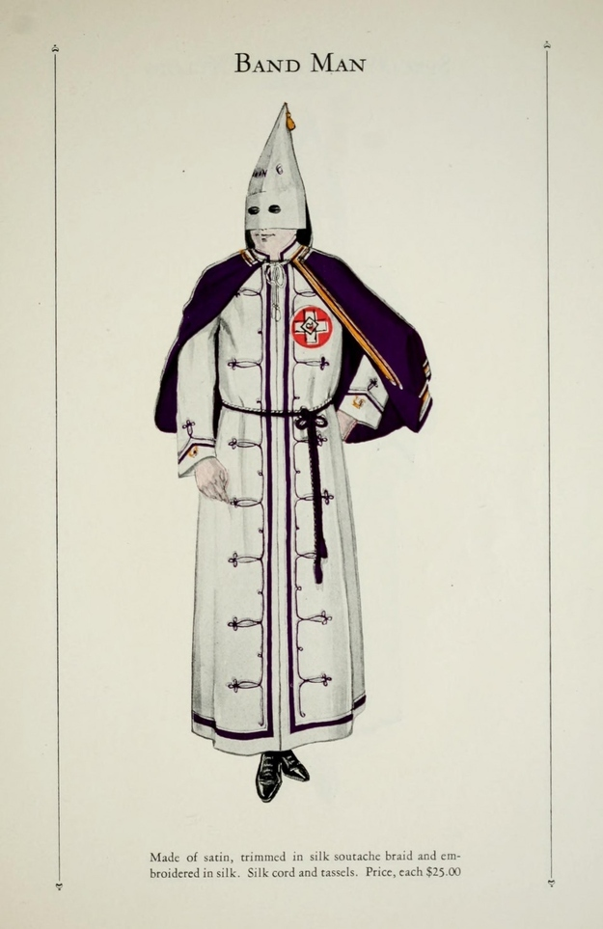
Notes:
… and went up to $25 if you wanted to go to, uh … Kland Camp.
So the Kleagle got a piece of all this.
And THEN they got to deputize sub-kleagles of their own to go out and recruit, and get a piece of their action,
And if there was enough cash left over to make it worthwhile, the sub-kleagles could deputize their own sub-subs.
The goal of it all was selling memberships and outfits.
The similarity to a Ponzi scheme is kind of striking.

Slide 31
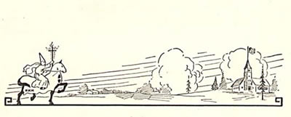
Notes:
Anyway: that’s where the Klan was when its tentacles first reached up from the south to fondle our fair state.

Slide 32
The Klan comes to Oregon
Notes:
Oregon’s Klan experience started early in 1921, when an outgoing salesman from Louisiana named Luther Powell crossed the border from California and settled into Medford ... with business on his mind.

Slide 33
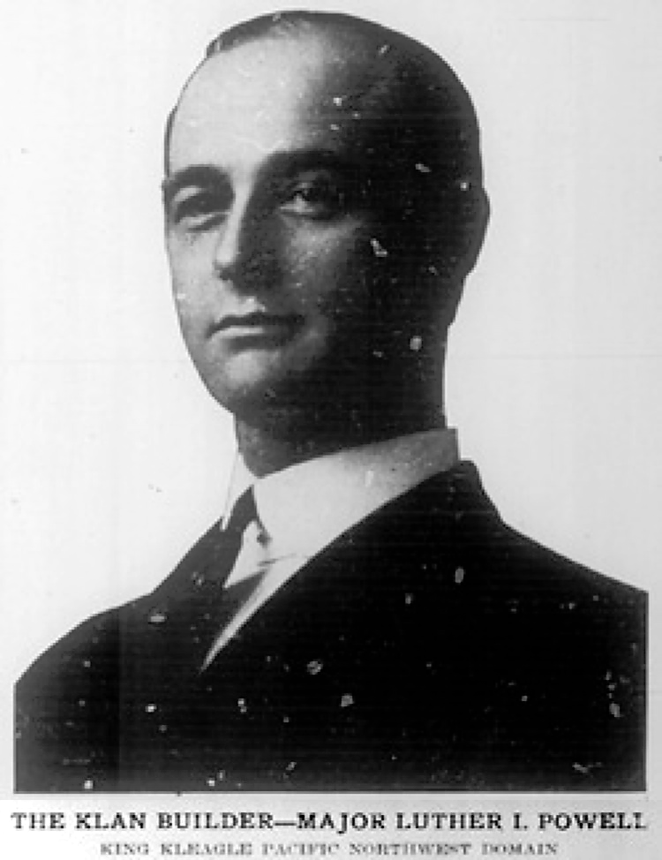
Notes:
Powell was a top-level Kleagle — a 40-percent man. And Oregon was wide open.

Slide 34
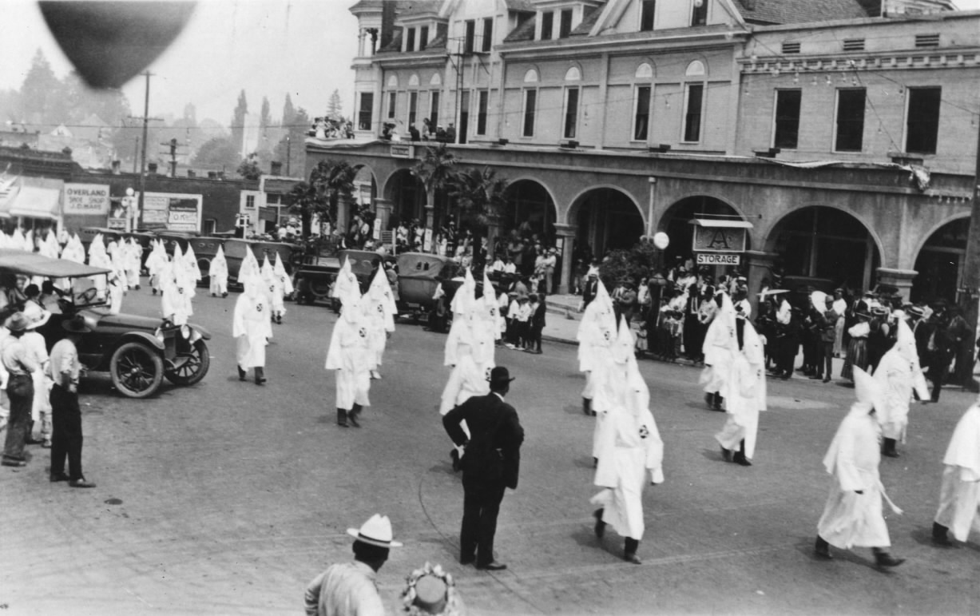
Notes:
He was wildly successful.
Just eight months after Powell first set foot in southern Oregon, the “invisible empire” had spread throughout Oregon like a virus infecting a host.

Slide 35
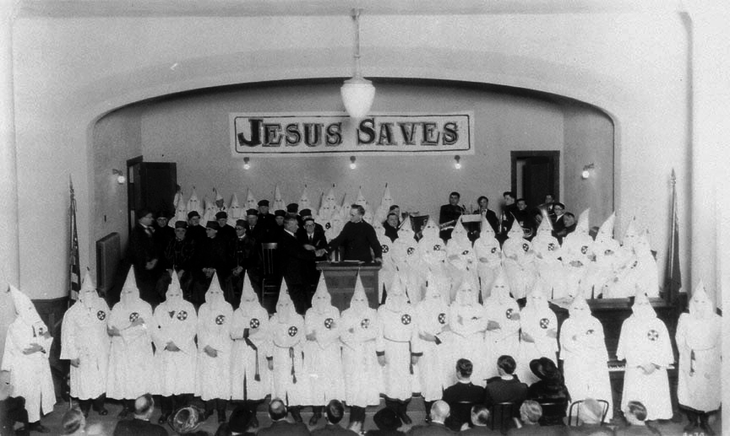
Notes:
Six months later, there were tens of thousands of Oregonians with white eyehole suits hanging in closets all over the state, and tens of thousands more who looked on the Klan as a force for good.
Seems weird to think about that, doesn’t it?

Slide 36
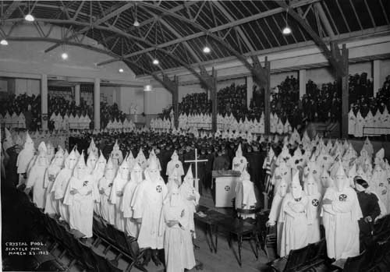
Notes:
How did they get there?
Well, they pretty much worked the system.
The ad agency folks had designed a pretty slick sales system, and all Powell really had to do was work it.
It came with a standard package, like a giant shipment of eyehole suits and contracts and stuff, plus a prospect list of key folks that Headquarters had sniffed out from far away.

Slide 37
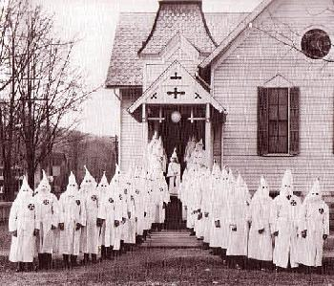
Notes:
Once he hit the ground in a new territory, the first thing a Klan recruiter was supposed to do was go and discreetly make connections with the conservative protestant preachers in the area.

Slide 38

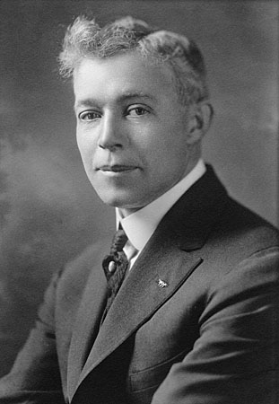
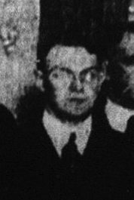
Notes:
Once that was done, the recruiter would spend some time tapping the shoulders of local government and law enforcement people:
cops … mayors … legislators, you name it.
Finally, Phase 3 would start, and that’s when the recruiter would actually start making the bucks.

Slide 39
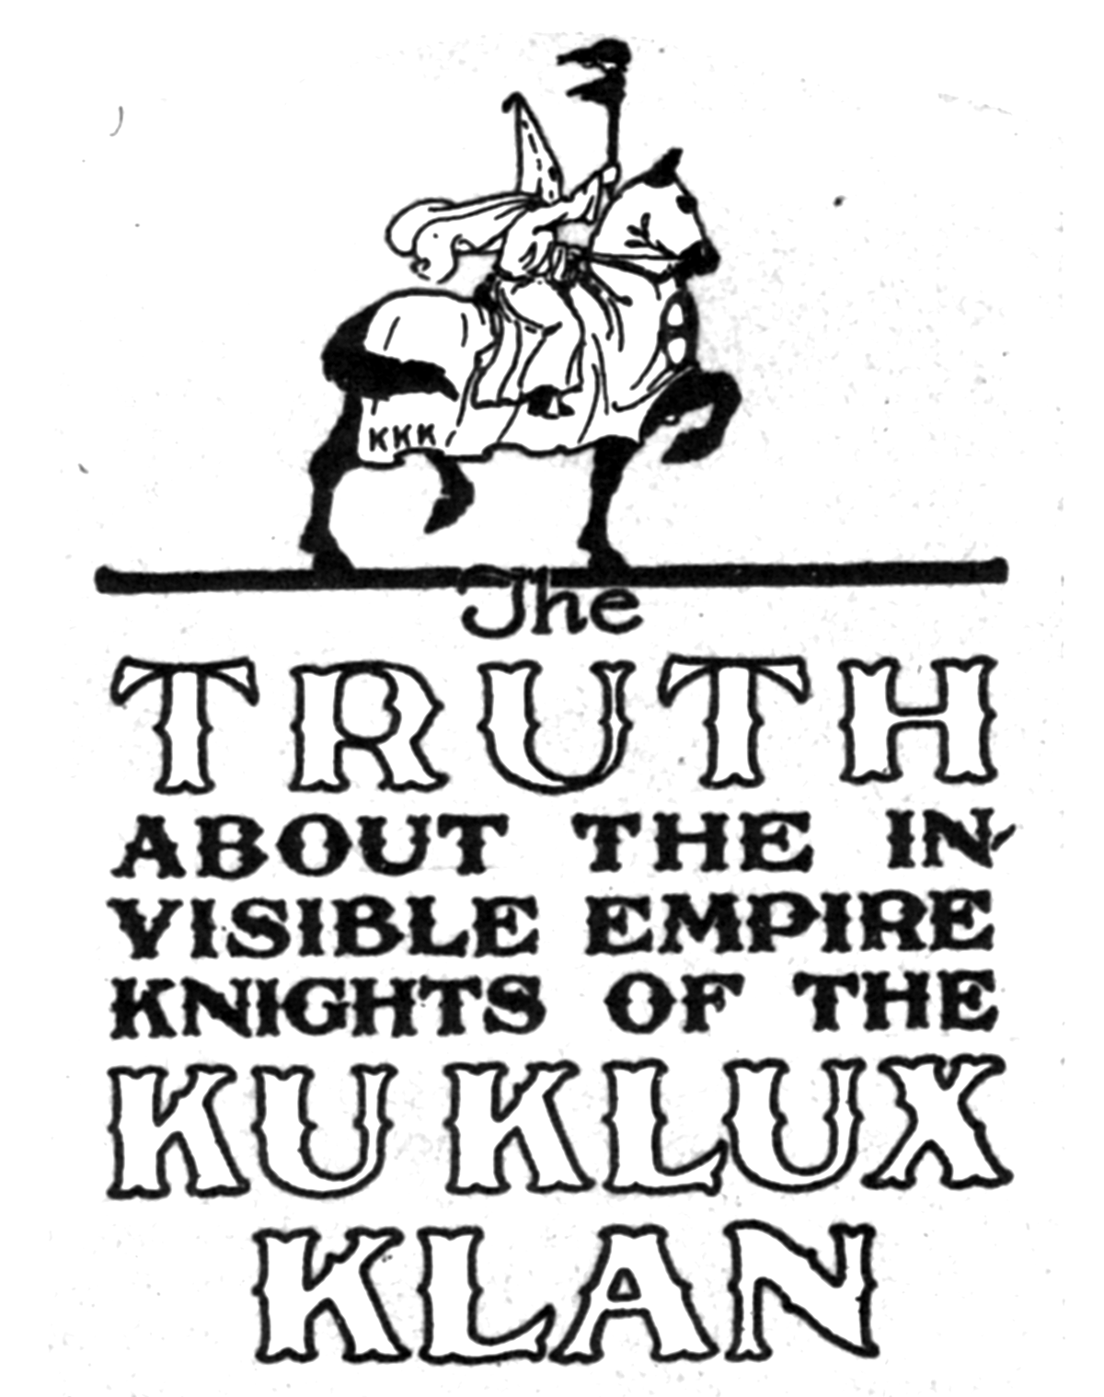
Notes:
They’d place big splashy ads in local papers inviting everybody in town to come to a “lecture” to find out what this “secret, mystic organization” was all about.

Slide 40
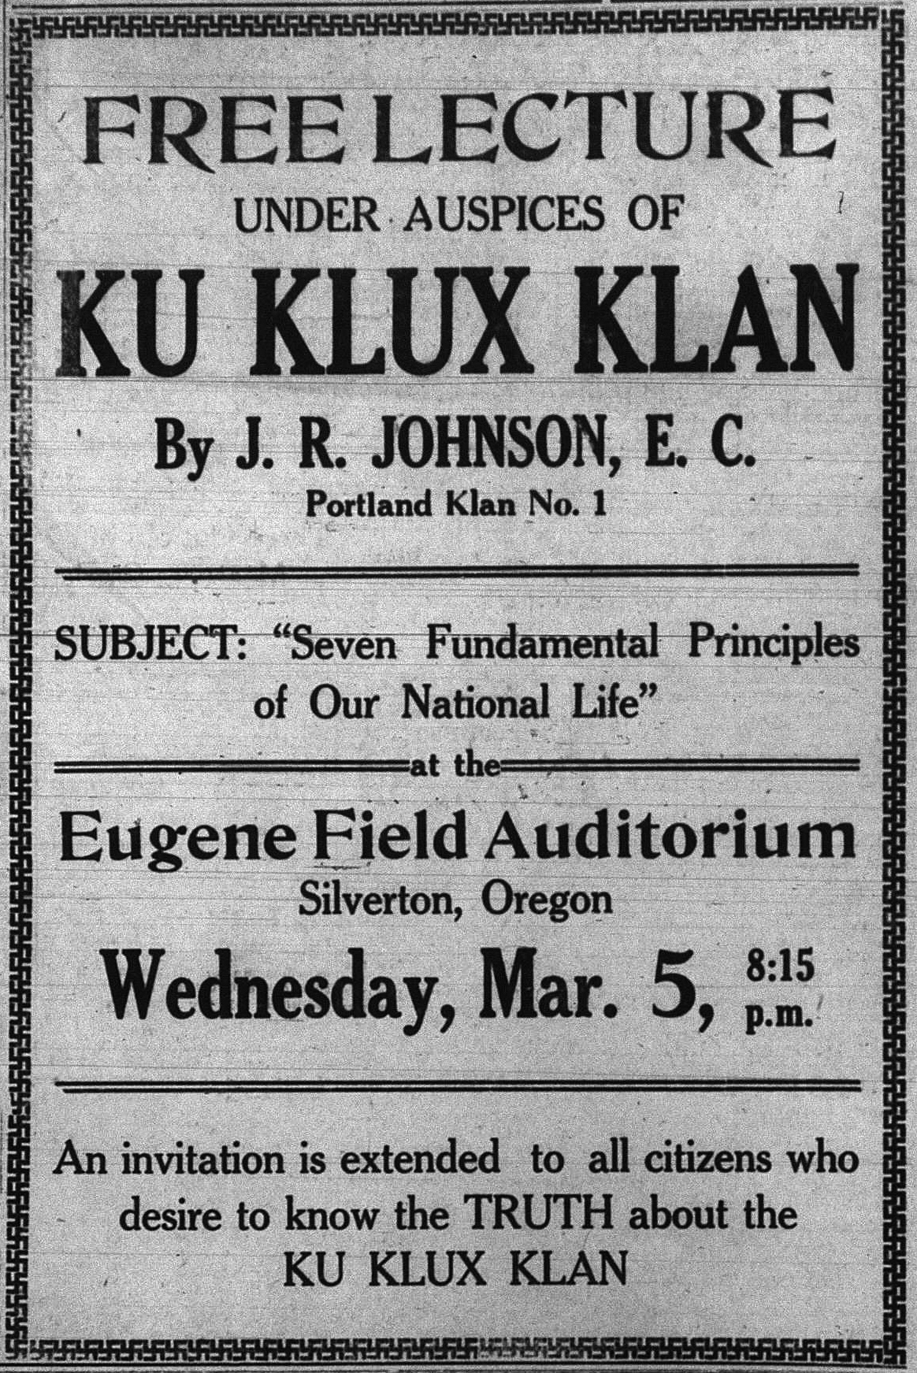
Notes:
Of course, the Klan was a secret society, so the promise was, come to this lecture and we’ll tell you what the hell it is.
Not a lot of people could resist that chance.
Once they showed up in the hotel ballroom or elementary-school auditorium or whatever, the recruiter and/or an especially enthusiastic pastor come out for a dog-and-pony show and lay down the sales pitch.

Slide 41
The Klan Takes Over
Notes:
By 1922, Oregon was shot through from one end to the other with dumbkluxx.
And these guys had been convinced that it was their duty to seize power.
Any power: school board positions, City Council seats, Utility commissions ….
… county commissions — more on that in a minute …
They were to seize it and wield it for the benefit of white Americanism, and brother, they got to it.

Slide 42
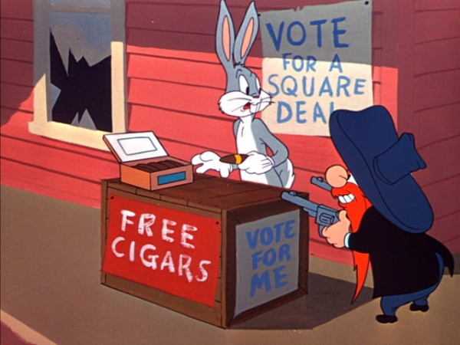
Notes:
So by the time the state and local primaries came around, there was a Kluxer running for practically everything.
And with all the other Kluxers running around doing their bit, they were all in pretty good shape to win.

Slide 43
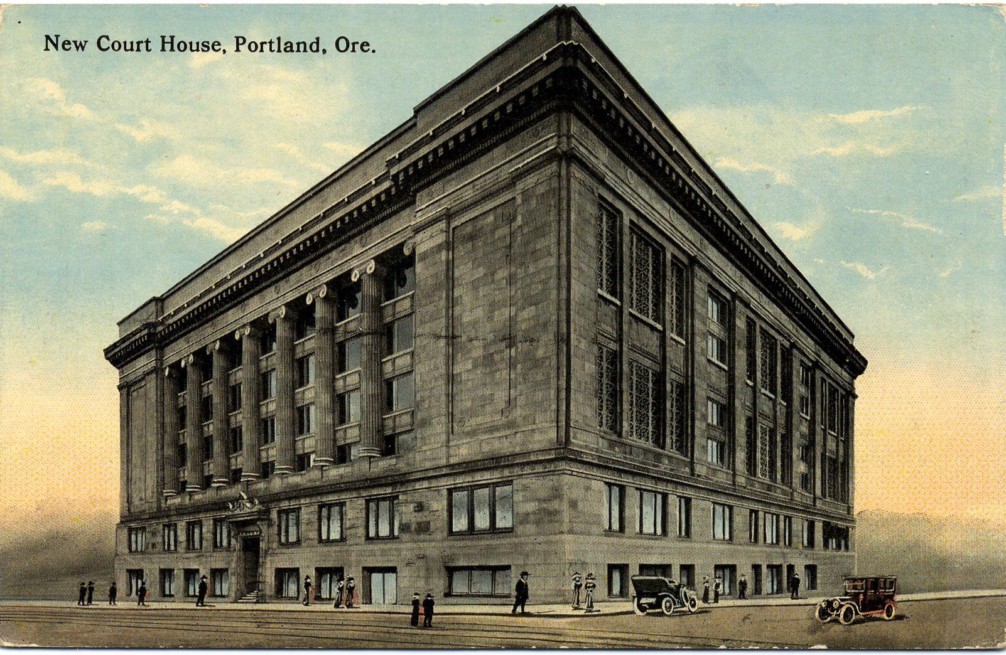
Notes:
Like to call your attention to one race in particular.
The Multnomah County Board of Commissioners already had a nice, Klan-friendly fellow, and two others were leaving.
The Klan was in a great position to put up two more friendly faces, and then the most powerful county government in the state would be a wholly-owned subsidiary.
That would go very well for them.
But it wouldn’t be too long before the Kluxers wished they’d kept out of it.
I’ll get to that shortly.

Slide 44
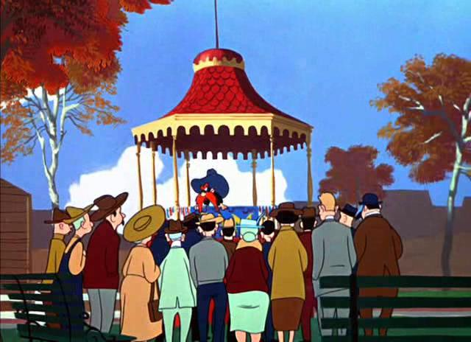
Notes:
In the elections that year, their hand-picked candidates — some of them members, some not — swept the field.

Slide 45
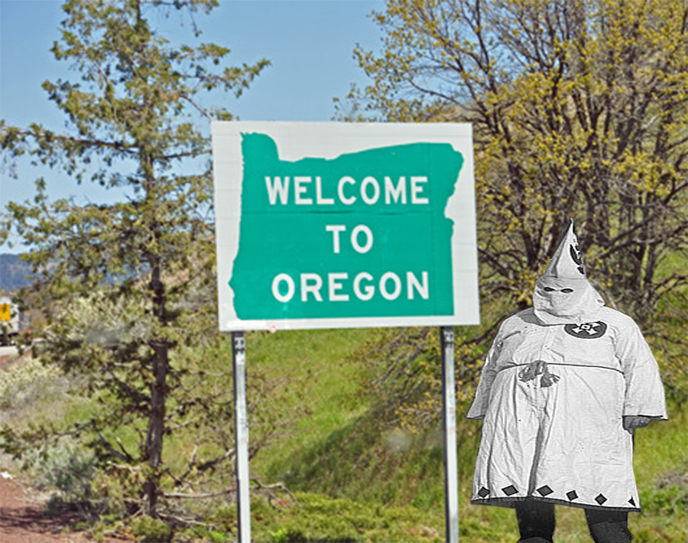
Notes:
So as 1923 dawns, the state of Oregon is completely dominated by the Klan, from sea to shining Snake River.

Slide 46
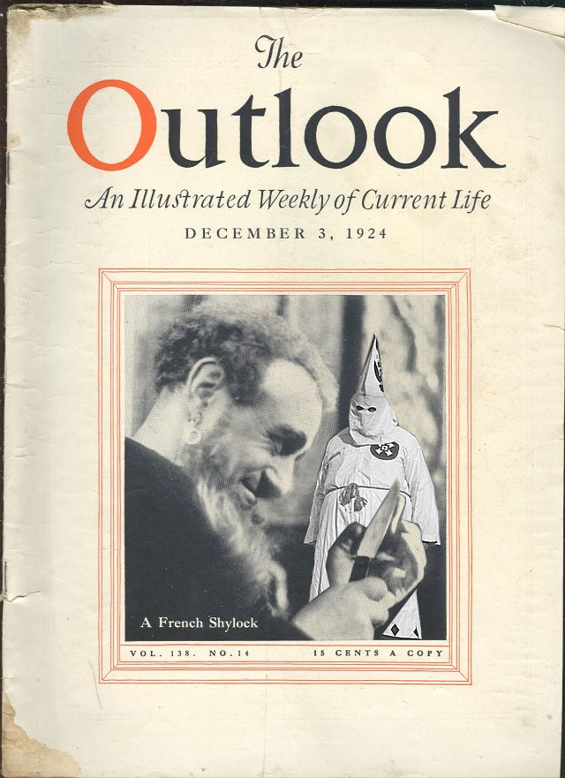
Notes:
Writer Waldo Roberts of The Outlook had a story in the March 14, 1923, issue titled “The Ku-Kluxing of Oregon.”
“There is something new under the sun,” he wrote. “Oregon, politically the most conservative and temperamentally the least romantic state west of the Rocky Mountains, is now under the control of the Ku Klux Klan.”
But … not for long.

Slide 47
Oregon under Klan rule
Notes:
For a little while, all was skittles and beer for the Klan in the Beaver State.
Or at least, they thought everything was skittles and beer.
The funny and ironic part is, they were very, very wrong about that.
Here’s why:

Slide 48
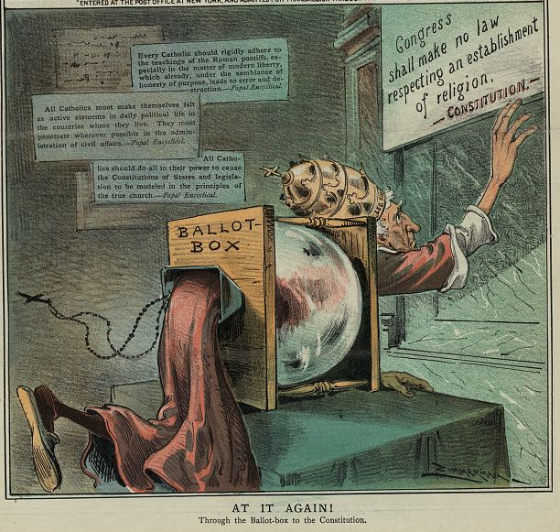
Notes:
After the 1922 elections, when the Klan had won almost every single election it had deigned to run for, its leaders quite naturally assumed that meant they’d been handed a massive mandate to remake Oregon in the image of their own particular ethnocentric agenda —
to crush the forces of Catholicism, keep the Jews down and make the few brave and hardy African American Oregonians finally give up and leave the state.
So they got right to work.

Slide 49
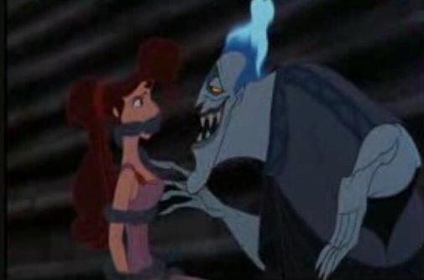
Notes:
But there was one teensy weensy but ever-so-crucial little tiny detail …
looking back on the whole episode with our historian’s X-ray goggles, we can clearly see that there was one key element that Oregonians found appealing about the Klan’s vision.
And it wasn’t what the Klannies thought it was.

Slide 50
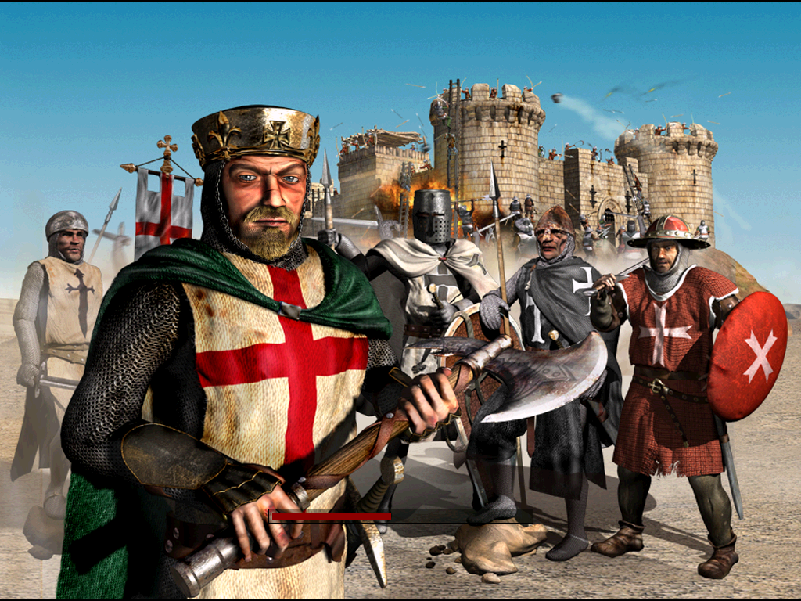
Notes:
It was the Klan’s focus on “moral uplift.”
See, the Klan considered itself the secret enforcement arm of the American protestant churches,

Slide 51
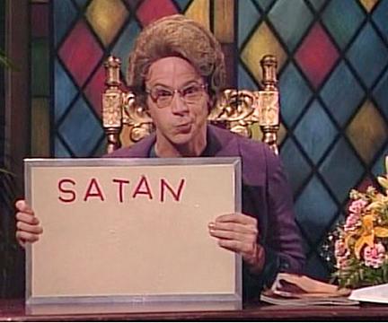
Notes:
and American Protestantism had rather a lot to say about things like lying, cheating, stealing money, embezzling from contracts, promiscuity, fornication … little things like that.
So the Klan had talked a lot about those things when appealing to people to vote for it.

Slide 52
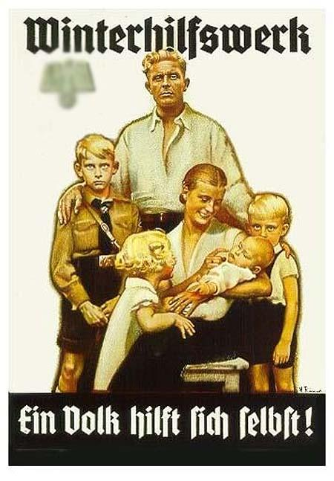
Notes:
The Klan, almost from the start, focused heavily on corruption in government and bad elements in society.
It promised to bring a wholesome, clean, bright, blonde, blue-eyed, virtuous alternative to that corruption and debauchery.
Kind of like somebody else promised, a few years later, in a certain European country.

Slide 53

Notes:
Most Americans had concluded that this guy had totally swindled them into supporting the First World War.
So they’d replaced him and his party with these guys —

Slide 54

Notes:
— who promised to make things “back to normal” again —
And then promptly President Harding got busted with his fingers in the till. — the Teapot Dome Oil scandal.

Slide 55

Notes:
Now here came this quasi-political outfit to say, “Hey, vote for our people. We’re a new kind of political force, one that answers to a higher authority.”
You can see how even non-racist Oregonians might have voted for that.
As the non-Klan-related public saw it, that was the nature of the mandate they had delivered:
To replace the old politics of corruption and embezzlement and graft with a new politics of personal virtue.

Slide 56

Notes:
And the trouble with that was, that’s not what the Klan thought its mandate was at all.
No, the Klan thought the important part of their massive ballot-box victory was the ethnic-cleansing part.
And that’s what they got started focusing on, right away.
A torrent of laws started coming out of Salem, clamping down on Catholic schools, Japanese and Chinese citizens, a blatantly unconstitutional literacy test for voting, and other pet projects.
But as for the whole politics-of-virtue thing, well … to the victor go the spoils, right?

Slide 57

Notes:
The real problem for the Klan was, it was becoming increasingly clear to large numbers of Oregonians that their talk about the politics of virtue and moral uplift didn’t count for much.
They were, if anything, even more corrupt than the politicians they’d replaced.
How corrupt? Ooooh … it’s finally time to talk about the bridge.

Slide 58
The Klan’s spectacular fall
Notes:
This is the story of the straw that broke the camel’s back.
And it was a helluva straw.
Before this happened, the Klan was still in OK repute.
Maybe there was a little disappointment, but nothing too bad.
After this story, the Tender Timer popped up.

Slide 59

Notes:
They were done.

Slide 60

Notes:
It all had to do with three iconic Portland bridges:
Sellwood, Ross Island, and Burnside.
Next time you’re on your way across one of those bridges, you gotta stop and feast your eyes.
At least until the guy behind you starts honking.

Slide 61

Notes:
You are looking at a monument to the destruction of the Ku Klux Klan’s power in Portland and in Oregon.

Slide 62

Notes:
Let me fill you in.
I mentioned the Multnomah County Board of Commissioners earlier, and I told you I’d have more to say about them later, right?
Well, now is the time.
In 1922, the election that packed that commission with Klansmen also gave them voter authorization to sell bonds to build three new bridges across the Willamette:
The Burnside, the Sellwood and the Ross Island bridges.

Slide 63

Photo courtesy Thomas Robinson of www.historicphotoarchive.net
Notes:
Burnside in particular was a problem.
The old Burnside Bridge was only 30 years old, but it was getting ready to kill someone.
It had deteriorated very badly, and was no longer safe, and that meant traffic was horrible.
Sellwood and Ross Island didn’t exist yet … more on that in a minute.

Slide 64

Notes:
Well, the commissioners were approved for $6 million in bonds to build those bridges.
And that happened in late 1922.
But then … a whole year went by, and it seemed like nothing was happening.
The City Council was furious; delays kept coming up and the Commissioners seemed to be just dragging their feet.
Actually, what they were doing was making secretive behind-the-scenes arrangements of the type that are only possible before a project has been publicly announced … if you know what I mean.
Well: Just as Portlanders started wondering what the hell was going on, suddenly — on April Fools Day, I kid you not, April 1, 1924 — the Commissioners finally put the project out for bids.
Almost instantly — as if on cue — a very unusual bid came into the office.
It came from a consortium of three contractors, and it was an all-or-nothing bid:
They either wanted all three bridge jobs, or none at all.

Slide 65

Notes:
SOLD!
The commissioners now moved with breathtaking speed.
They pounced on the bid, announced that it was accepted and slammed the door closed on the bidding process.
The window had been open for less than 24 hours.
It really was true: If you didn’t come see them today …

Slide 66

Notes:
… you couldn’t save them any money.
But of course, they didn’t want you to save them any money.
Which is why what happened next caused them so much trouble …

Slide 67

Notes:
You see … they didn’t move quite fast enough.
Because somebody else was out there waiting for the commissioners to open that window.
Somebody who just happened to be ready with a bid for construction on the Burnside Bridge only — not the other two.
Somebody who was ready, willing and able to build that bridge for a half million dollars less than the other guys.

Slide 68

Notes:
I still don’t understand how the commissioners could be dumb enough not to realize they’d been outplayed.
First off, you don’t cook up a bid for a $2.5 million bridge project in two hours over Spanish Coffees at Huber’s.
That’s weeks’ worth of work, maybe months.
Somebody had done that work and had been holding back, waiting and clearly knowing that the commissioners were planning something like this.
When the window opened, they were ready.
You know they didn’t think that far ahead without having a contingency plan for what to do when the commissioners rejected their bid — as they clearly knew would happen.

Slide 69

Notes:
But the commissioners quickly took the bait:
they rejected the bid on grounds that it was only for one bridge, not three; and quoted 500 days’ construction time rather than 300.
Again, I’m not sure what the commissioners thought was then going to happen.
Perhaps they assumed this spurned bidder, who had invested thousands of dollars in preparing a bid that should have won the job and had clearly been rejected for illegal reasons, would just shrug and go, “Oh well.”

Slide 70



Notes:
If so, they were in for a big surprise.
Within hours the word was all over the city and people were starting to get angry.
Then retired governor Oswald West weighed in on it.

Slide 71

Notes:
“Those who are putting over the deal are working fast,” he told an Oregon Journal reporter, “and unless something is done at once the taxpayers of the county and city are going to get a wonderful trimming.”

Slide 72

Notes:
A recall petition was started almost immediately.
Seemingly in response, the commissioners hurried up and cut a huge check to the consulting engineers from the winning bidder.
… Now why do you suppose they did that?
Stay tuned, I’ll tell you — but at the time, it just made things worse.
They were $124,000 into a contract with a consultant that was supposed to only have charged $40,000 for what they’d done so far. WTF?
Newspaper headlines got bigger.

Slide 73

Notes:
The astonishingly tone-deaf commission didn’t budge.
The city had really needed three bridges, they explained earnestly, and if they’d accepted the Burnside contract they would have had to reject the three-bridge package, and schedule another round of bidding, which would have delayed the Ross Island and Sellwood bridge projects.
Did I say they wouldn’t budge? I misspoke. They budged.
Specifically, they ordered the Burnside Bridge to be shut down again.
People interpreted that as an attempt to increase the pressure for the shorter (and more expensive) contract. They got even madder.

Slide 74

Notes:
Then the Commission tried to explain away the half-million dollar difference in the bid prices by claiming that the package-deal contractors were expecting to build the Ross Island Bridge at a loss, and make it up by padding the Burnside Bridge contract.
Sounds legit, right?
Yeah, that’s what the Portland voters thought too.

Slide 75

Notes:
In any case, the chairman assured the public — no doubt with good eye contact and an earnest Checkers-Speech-like air of frankness —
“As all the facts regarding the contracts become known we are confident it will be seen that we acted wisely and that the people of the county will approve of our action.”

Slide 76

Notes:
Unfortunately for the commish, the facts that came out next were not the ones he had in mind.
This headline, about a $50,000 bribe, was the first bit.
There was soon more.
For instance: Five days before the bridge placement plans were announced, one of the commissioners had bought options on 18 city lots right next to what he and the other commissioners — and nobody else — knew would be the west end of the Sellwood Bridge.

Slide 77

Notes:
Probably right about here.

Slide 78

Notes:
And even worse: A cabal of city and county officials, including two commissioners, had bought two city blocks at the end of the Ross Island Bridge —
blocks that would be required for bridge support, meaning that the owners could all but name their price.
And just a few days before plans were announced, guess who they’d sold them to?
The consulting company that got the $124,000 payment just a few days before, that’s who.
So that $124,000 must have been pretty close to the price they named.
And $124,000 was — let’s just say it was a buck or two above fair market prices for city lots back in ‘24.

Slide 79

Notes:
All told, the various skimmings and trimmings by the commissioners and their friends would have added a full million dollars to the cost of the project —
— plus the half-million bucks that the contractor was overcharging for the Burnside Bridge.
Now, that’s efficient government.

Slide 80

Notes:
This is about the point at which the number of people who had signed the recall petition exceeded the number of voters who would have to vote yes to kick them all out.

Slide 81

Notes:
The Portland Klavern, however, continued laboring mightily to stem the tide, urging Portlanders not to be hasty, trying to protect its protégés.
The result of this was basically that most of Portland ended up concluding that a secret vigilante organization that defended such obvious crooks could not possibly be much good itself.

Slide 82

Notes:
By early summer, the commissioners were gone, and the Ku Klux Klan’s support was collapsing like one of this guy’s cunning plans.
This is from the Klan robes catalog, by the way. It seems they actually had a Klan office named Baldric. Somebody needs to let Rowan Atkinson know about this because I think there’s some comic potential here.
Then, suddenly, rumors started circulating — rumors that turned out to be true — that Grand Dragon Fred Gifford was using the Klan as his own personal cash kitty.

Slide 83

Notes:
All this bad news had come along in the summer of 1924, right?
You know what happens in November of even-numbered years …
… that’s right. The Klan took a massive and vigorous beating at the polls.
Those who could rushed to disclaim any affiliation with the “mystic” organization that had gotten them elected.
For most of them, it wasn’t enough.
Mayor Baker got re-elected, but just barely.
Governor Pierce was not up for re-election, but the Legislature that was sworn in was virtually pledged to oppose him at every turn — and did.

Slide 84

Notes:
By 1925, the Klan was still pretty strong in most of the rest of the country.
It wouldn’t fall out of fashion in most places until the late ‘20s, or even the early ‘30s.
But not in Oregon.
There were a few rural outposts in the hinterlands where it soldiered on, but in the major Willamette Valley cities, for the Klan … it was curtains.

Slide 85
Epilogue
Notes:
My story is done, but I have one other thing to say, and that is this.
When I was a kid, going to Catholic summer camp, we whispered fearful Ku Klux Klan stories to each other over the campfire.

Slide 86

Notes:
It was kind of like ghost stories … it was fun.
And that’s the difference between members of ethnic groups targeted by the Ku Klux Klan who aren’t of African descent — like me — and those who are.
Because scary as those pointy-hatted idiots were to me and my friends, they weren’t much more to us than ghosts.

Slide 87

Notes:
Can you even imagine a group of black children sitting around a campfire swapping Ku Klux Klan stories?
I don’t know of a single Catholic who was ever lynched by a gang of Ku Klux Klan thugs.
Thousands and thousands of black guys, over the years, were, both by the old Klan and the new one, and that’s just the ones we know about.
When you add in stuff that looked like an accident ... it gets huge.
In researching for this story, I came across several pictures of lynched teenage boys.
I’m not showing you any of them, because (a) we don’t need to roll in it, and (b) it’s not respectful to those kids.
But it’s easy to forget, because the Oregon klan was so relatively benign, that it was part of a nationwide organization that was killing people and using their lifeless bodies as advertising messages.

Slide 88

Notes:
One of the ways we give the back of our hand to people who richly deserve it is to ridicule them, to poke fun.
We’ve been doing that with these Klan people all night.
But … I think we always need to keep in mind that it’s a lot easier to do that when you’re not a black American.

Slide 89

Notes:
It’s something to keep in mind.

Slide 90

Thanks for coming out!
THIS is my public-history Website, with
300 newspaper columns going back to 2008, and
links to the daily podcast and news feed.
Please check it out!
offbeatoregon.com
THIS is my new project, which launches today.
Swing by and check it out! We’re discussing “A Princess of Mars” by Edgar Rice Burroughs.
Friend me on Facebook: facebook.com/finn.jd.john
Follow me on Twitter: @offbeatoregon
Find me on iTunes: offbeatoregon.com/itunes
Heckle me via e-mail: fz@finnjohn.com
Notes:
Thanks for coming to my show, you guys!

